Slide 1
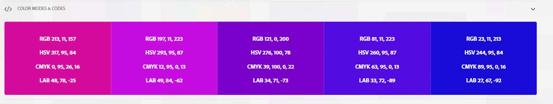
Machine Learning Model Deployment
How to deliver Machine Learning from Experiment to solutions
Benedictus Aryo
Notes:
Hi Everyone,
Today I want to share about Machine Learning Model Deployment.
In some cases like in the Big Top Company, they distinguished this role, like Data Scientist, Data Engineer, Machine Learning Engineer, even the Back End and the Front End
But this talk assume that we are data Scientist, which as we do, our responsibility was doing analytics and creating machine learning models to solve business case.
So again since this is sharing sessions, I will talk about how to deliver machine learning solutions as my perspective, and you might have other ideas as well.

Slide 2
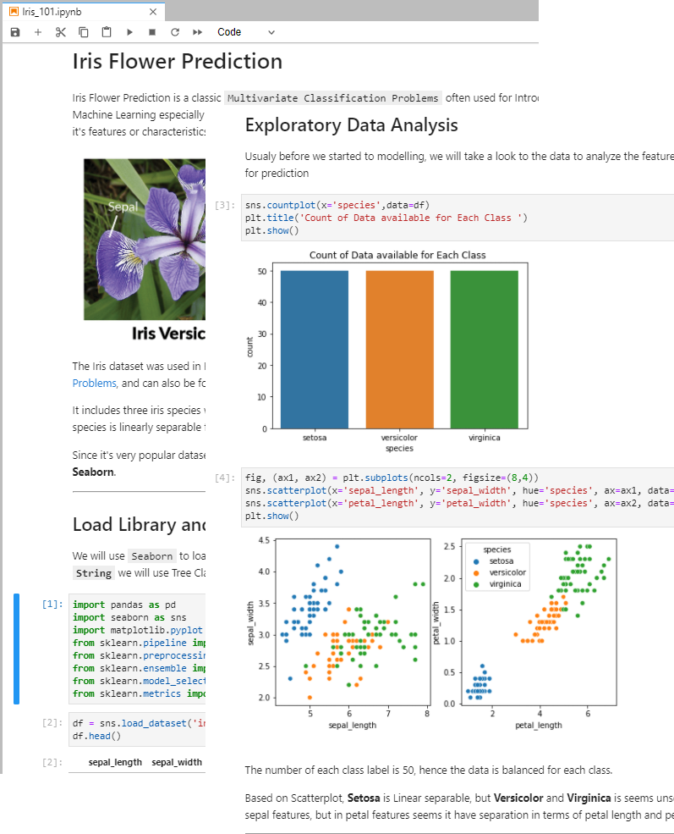
Let’s imagine this scenario
After finishing your Analysis on a dataset and finally you created the best performance machine learning model in Jupyter Notebook.
How can people make use of your result ?
Notes:
So, Let’s imagine this scenario
Because this might be familiar for us
So imagine we are asked for Doing analysis about a dataset, since this is just for Example, the dataset is Iris Flower Dataset (which is kind of hello world for data science)
We doing EDA in Jupyter Notebook and we creating machine learning models, which can classify Iris Flower Species based on its characteristics (or we call it features) like the Sepal and Petal, both the length and width
After some model selection and hyperparameter tuning, we found the best combination of model and it’s parameters.
Now the question, How can people make use of our result so others can benefit from our hard work ?

Slide 3
Can we just send them the Jupyter notebook files and let them run it ?
They should have Anaconda or Jupyter Notebook / Lab installed right ?
Notes:
We might think,
Can we just send them the Jupyter notebook files and let them run it ?
Because maybe we runs out of energy after doing what we did on Jupyter Notebook, so we though ok, I’m finished let’s just send the .ipynb files
But again, to runs jupyter notebook files, they might need to have anaconda / jupyter notebook installed right ?
Which is kind of a tedious process sometimes

Slide 4
Depends on..
Are the users know how to set up Python Environment ?
Yes
Are the users need to know python programming ?
Yes
Are the users Data Scientist or Machine Learning Engineer who want to know your process of thinking?
Yes
Then Just send the Jupyter Notebook Files ☺
No
No
No
Then we need to make something else
Notes:
But ok,
Maybe our users is really a fellow Data Science, or our IT collague which may know one or two about python,
So this is my way of thinking,
3 out of one cases We may need to make something else other than the jupyter notebook files

Slide 5

Questions to help us consider
What are the machine learning solution purposes?
Who are the users?
What is their level of knowledge?
Where the solution will be run ?
What is the requirement ?
Notes:
So ok,
The answer from previous slide is we need to make something else
Now, we can take a deeper look about what is the consideration when we make something else as machine learning solutions
Like, what is the purposes, who are the user and how they might gonna use it ?
For example if the users is spread across some places, we may think that it should be accessible through the internet
Or maybe the purpose is for automation, so the machine learning is runs by schedule in the server.

Slide 6







Then We can make a choice
Script / Console App
NO
YES
GUI/
Desktop Application
Need Graphical User Interface ?
Run Local / Offline
Interactive Web App
API /
Web Server
Machine Learning Solutions
NO
Simple
Need Graphical User Interface ?
YES
Complexity & Security
Complex
Run on Network / Internet
Full Website with Database and Login
Notes:
The process of though in previous slide can be translated into this diagram
Like whether it’s accessible Offline which is directly in the desktop client or server
Or maybe like mentioned in previous slide, the user is spread across the country for example, then we should make it accessible for them
And another considerations for example, if there’s existing application like android or IOS App, and we just want to integrate our machine learning, we can just serve the model as API or Web Service using Flask for example since we don’t need to create user interface.
But if we need user interface, we still can do that using Python streamlit for example,
Or maybe the requirement is quite bit complex like integrating with database, limiting the user access since it’s accessible through the internet, so maybe we need to have user login as credential we can serve our machine learning as Full Web app using Django framework.

Slide 7
Run on Local / Offline App
Python Script
Model Deployment using Console Script is the most easiest and common method to serve the functionality of the program.
Script usualy purposed to do automation or scheduling which doesn't need UI Interface.
Desktop GUI using DearPyGUI
Model Deployment using Desktop GUI using python can become an options if we want to make a Desktop GUI Application so that user can interact with the application interface such as slider and button.
Notes:
Since this talks will be less theoretical but more practical, I will explain this last 2 slide as Demo

Slide 8
Run on Network / Internet
Web API using Flask
In some cases we may need more powerfull hardware to do computation so by providing Web Service/API, existing user application like android app can just send REST Request for machine learning prediction
Interactive Web App using Streamlit
If we want to serve the Prediction application in the server as a web application so that it will be accessible through the network/internet and also user can freely access and interact to the machine learning interface directly, we can make Interactive web application.
Full Website with Database & Login
If we want to make our web app can store data in database format and also make access restriction to only some user that allowed to use the machine learning app, we can create Full Website that allow us to utilize database and manage user access.

